Slide 1




Political stance prediction based on the structure of diffusions
Advisors:
Christine Largeron
Andrei-Marian Rizoiu
Author:
Andrei Mardale

Slide 2

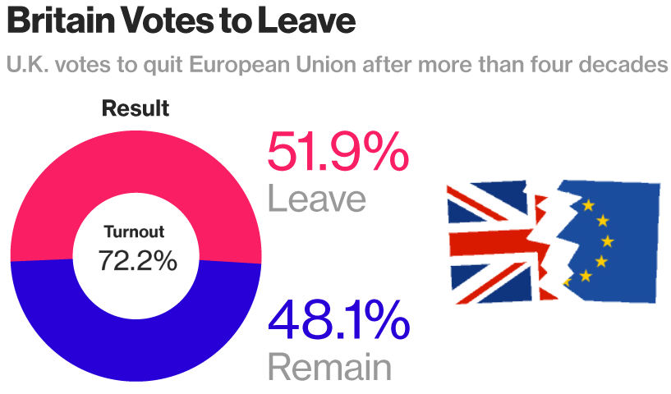
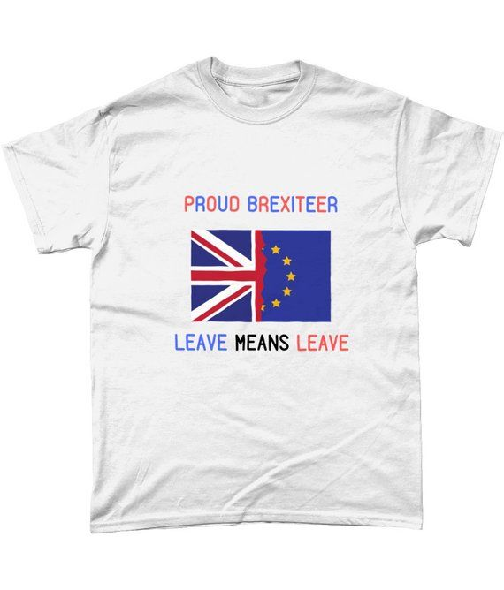

Motivation
Aim: predict the opinion of NEUTRAL users, based on the structure of their communities and conversations
Notes:
We looked at the most important events that involved voting for instance Brexit
brexit won my small margin, maybe neutral played an important role

Slide 3
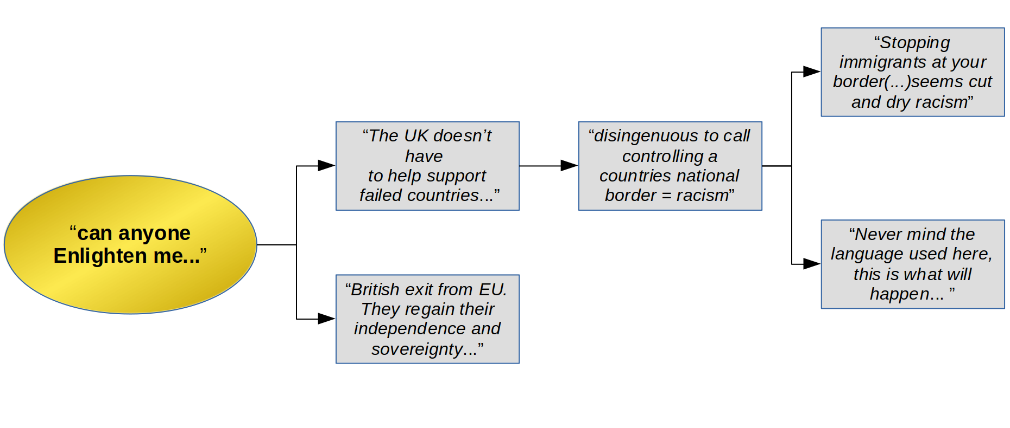
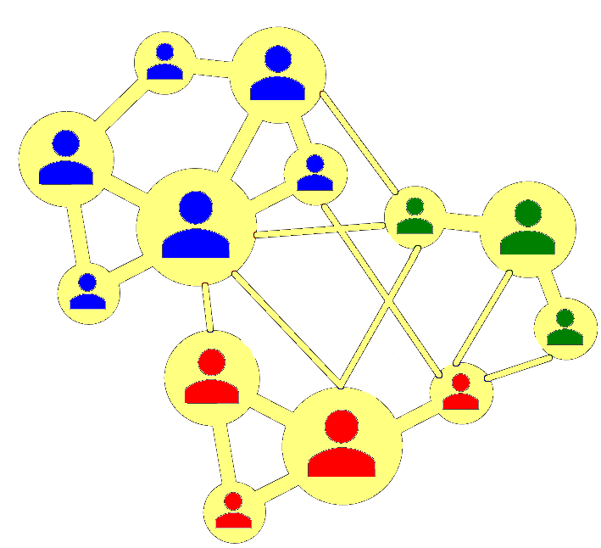
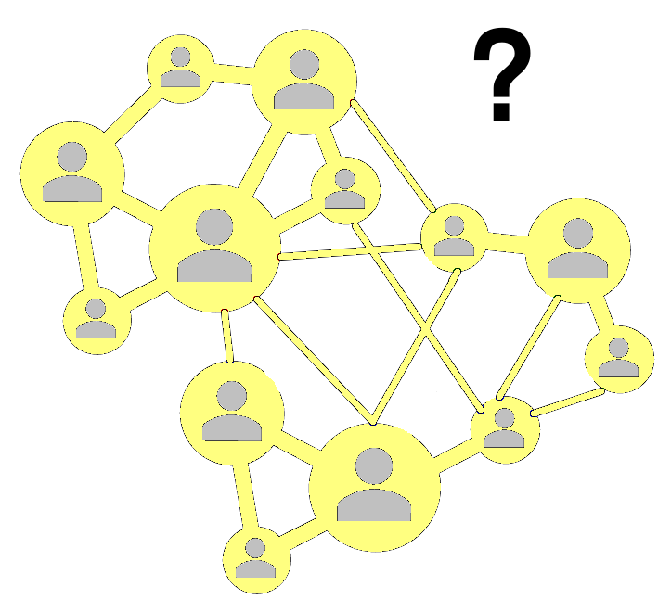

Our research objectives
1
Analyse the social influence of online discussions on users’ future political opinions
Notes:
Aim: predict future political stance of users based on the interactions with other users and the structure of their conversations

Slide 4
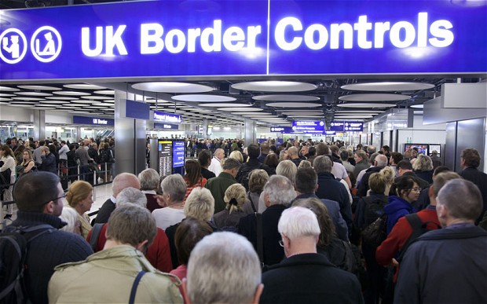
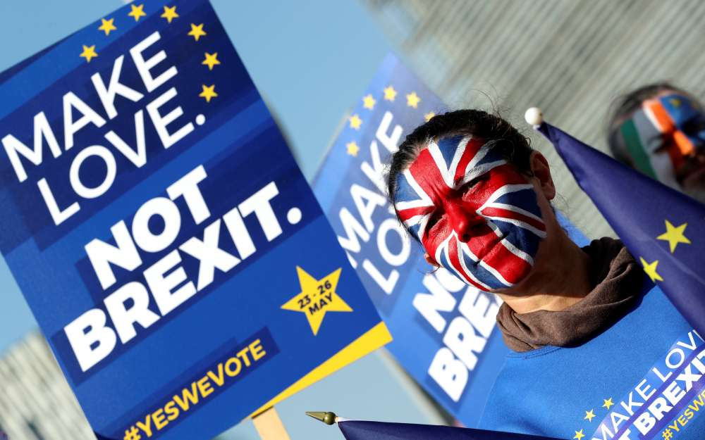

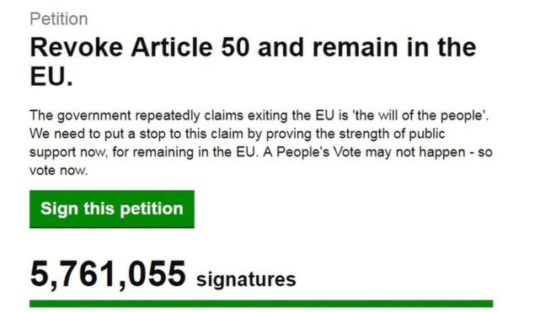
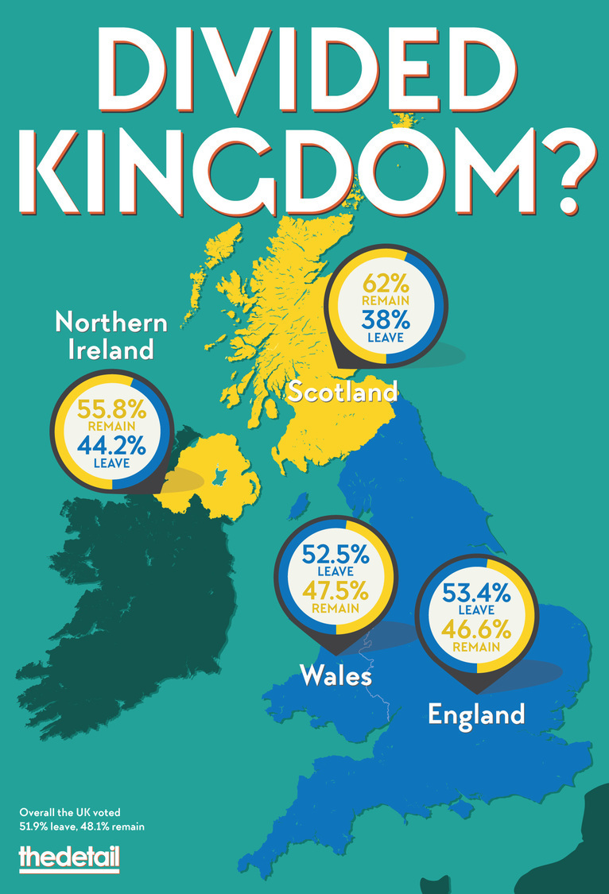
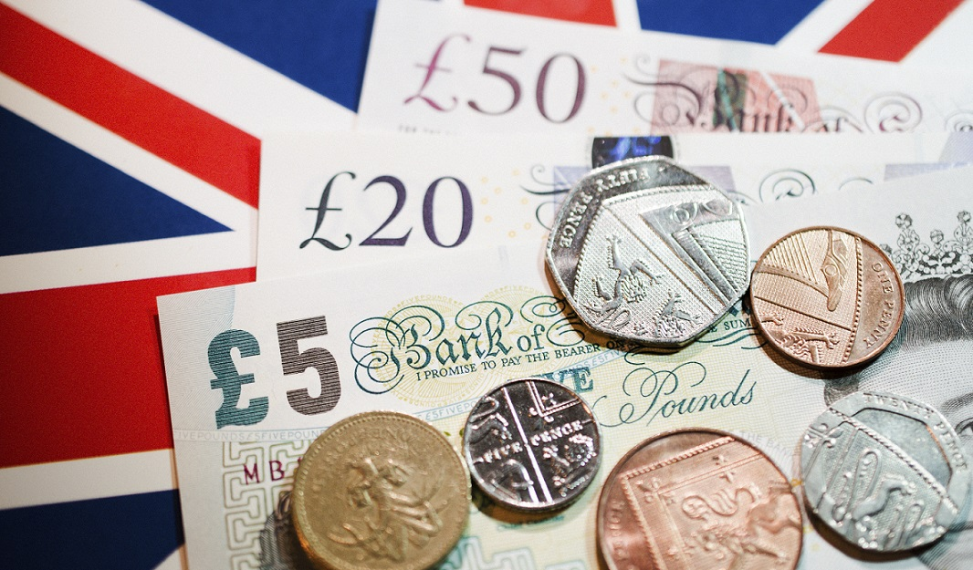
Our research objectives
2
Evolution of topics in online social networks around Brexit
Notes:
1) Temporal evolution of discussed topics in online social networks around Brexit

Slide 5






Presentation Outline
State of the Art
Dataset
Longitudinal analysis of topic evolution
Political Stance Predictor
Results
Conclusion and future work

Slide 6

State of the art
Myers, Seth A., Chenguang Zhu, and Jure Leskovec. (2012) “Information diffusion and external influence in networks.”
Shuai, X., Ding, Y., Busemeyer, J., Chen, S., Sun, Y., & Tang, J. (IJSWIS , 2012) - “Modeling indirect influence on twitter.”
Benoit, K. and Matsuo, A. (2018) - “Network analysis of Brexit discussion on social media.”
Information Diffusion – spreading of information from node to node along the edges of a social network
Social Influence – process in which an individual’s thoughts, feelings or actions are affected by other people
Political Stance Classifier – labels users as pro / against Brexit.
Our contribution: opinion prediction based on the structure of the communities and diffusions applied on Brexit.
Notes:
Our work places itself in the field of Social Behavior of online users, and in this domain, one important notion discussed by … is Information Diffusion, which means spreading
Information can reach a user via the links of the social network as part of diffusions or through the influence of external sources.
The origin of information propagation in social networks comes from social influence, which occurs when an individual’s thoughts, feelings or actions are affected by other people.
Detecting stances of users on the Brexit topic using twitter

Slide 7





Presentation Outline
State of the Art
Dataset
Longitudinal analysis of topic evolution
Political Stance Predictor
Results
Conclusion and future work

Slide 8


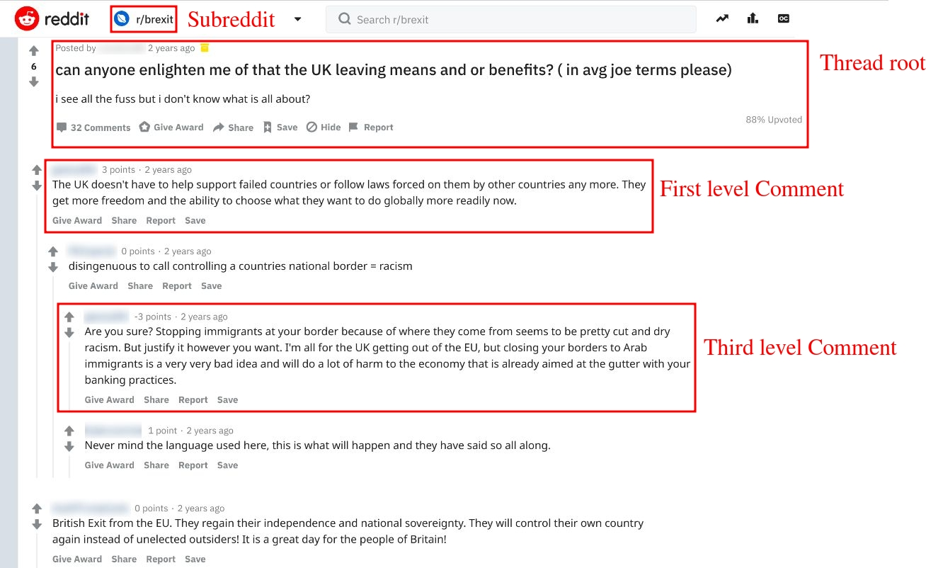




Case study
21,725 initial threads
207,894 comments
14,362 users
Nov. 2015 – Apr. 2019
Notes:
Reddit dataset – ideal for longitudinal study, having structured content in subreddits and tree like threads.
Left - example of a discussion thread, with multi-level comments, inside a subreddit.

Slide 9
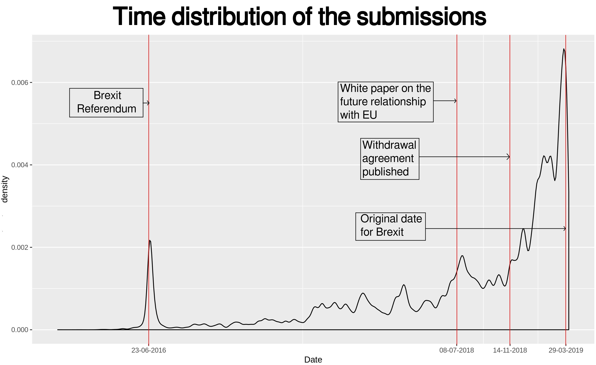
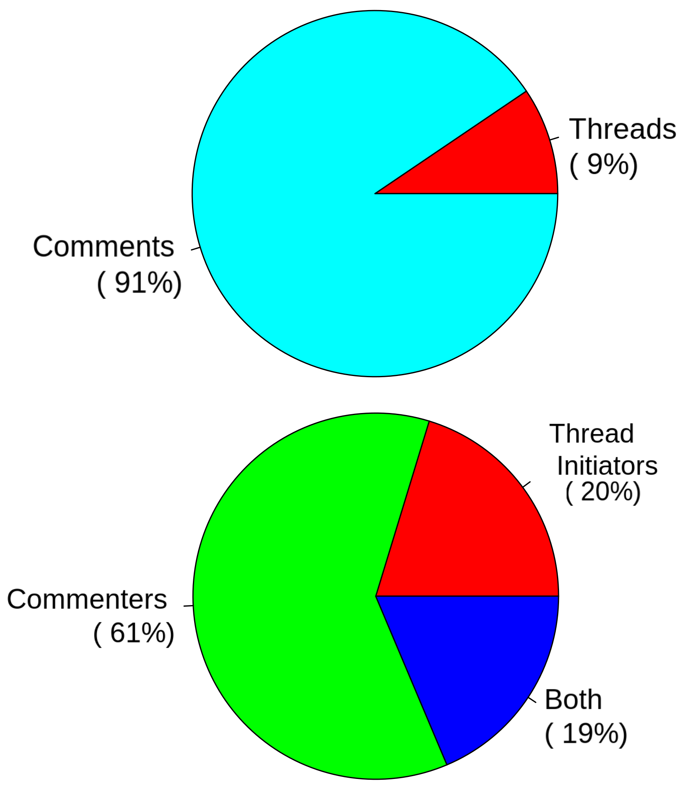
Structure of the dataset
Notes:
The interest for the subject of Brexit has been growing considerably and has constantly echoed the political decisions.
Left: Temporal distribution of the posts. The ascending trend is only perturbed
by the initial peak, on the 23 June 2016, when Brexit Referendum was held. Right: Distribution
of submitted messages and distribution of users in terms of roles. People tend to
comment more on already commenced threads.

Slide 10

Presentation Outline
State of the Art
Dataset
Longitudinal analysis of topic evolution
Political Stance Predictor
Results
Conclusion and future work

Slide 11
Event-Based messages split in 15 time-periods
T1
...
T2
T13
T15
T14
...
T5
20.03.2019 - May obtains an extending of Article 50
5.05.2019 - May requests a 2nd extending of Article 50
13.07.2016 - Theresa May accepts the invitation to form a govern
29.03.2019 - The original planned date for Brexit
23.06.2016 - The UK holds a referendum on whether to leave the EU.:51.9% of votes leave
24.06.2016 - David Cameron resigns as Prime Minister
29.03.2017 - UK invokes Article 50, with a due leave date on 29 March 2019
Notes:
The posts were split temporally in 15 time-periods, following an Event Based Strategy, so that each timeframe will reflect a particular subject

Slide 12
Longitudinal analysis of topic evolution
Words distribution per topics
KL
Divergence
Messages
Aggregation
LDA
[Blei,Ng&Jordan, 2003]
Topics distribution per users discourse
K-Medoids
[Reynolds, Richards, de la Iglesia & Rayward, 2006]
T-SNE
[van der Maaten&Hinton, 2008]
Notes:
For each period, each user’s messages were aggregated and using LDA, we determined the probability distribution of the 10 most present topics in their discourse.

Slide 13
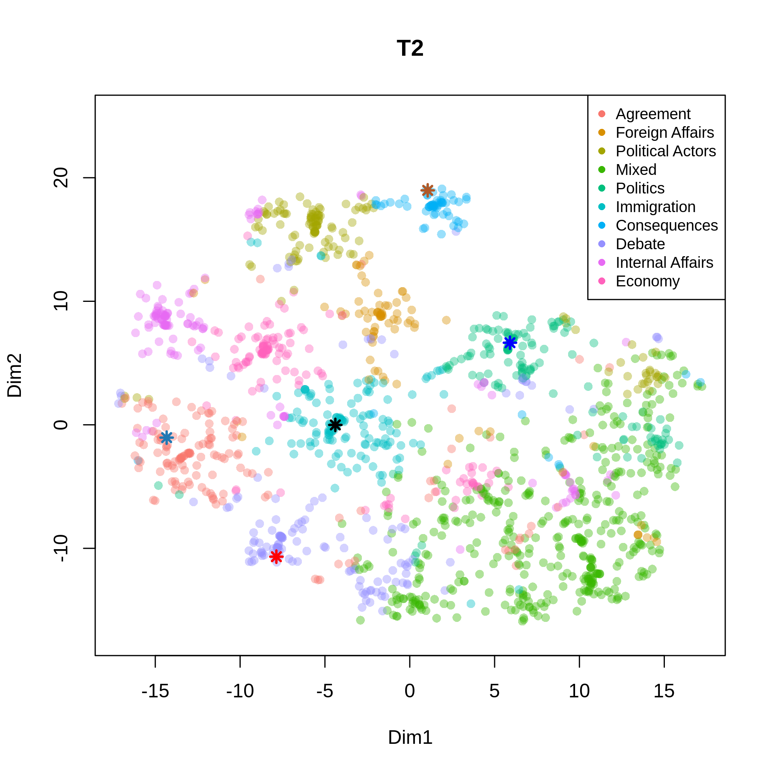
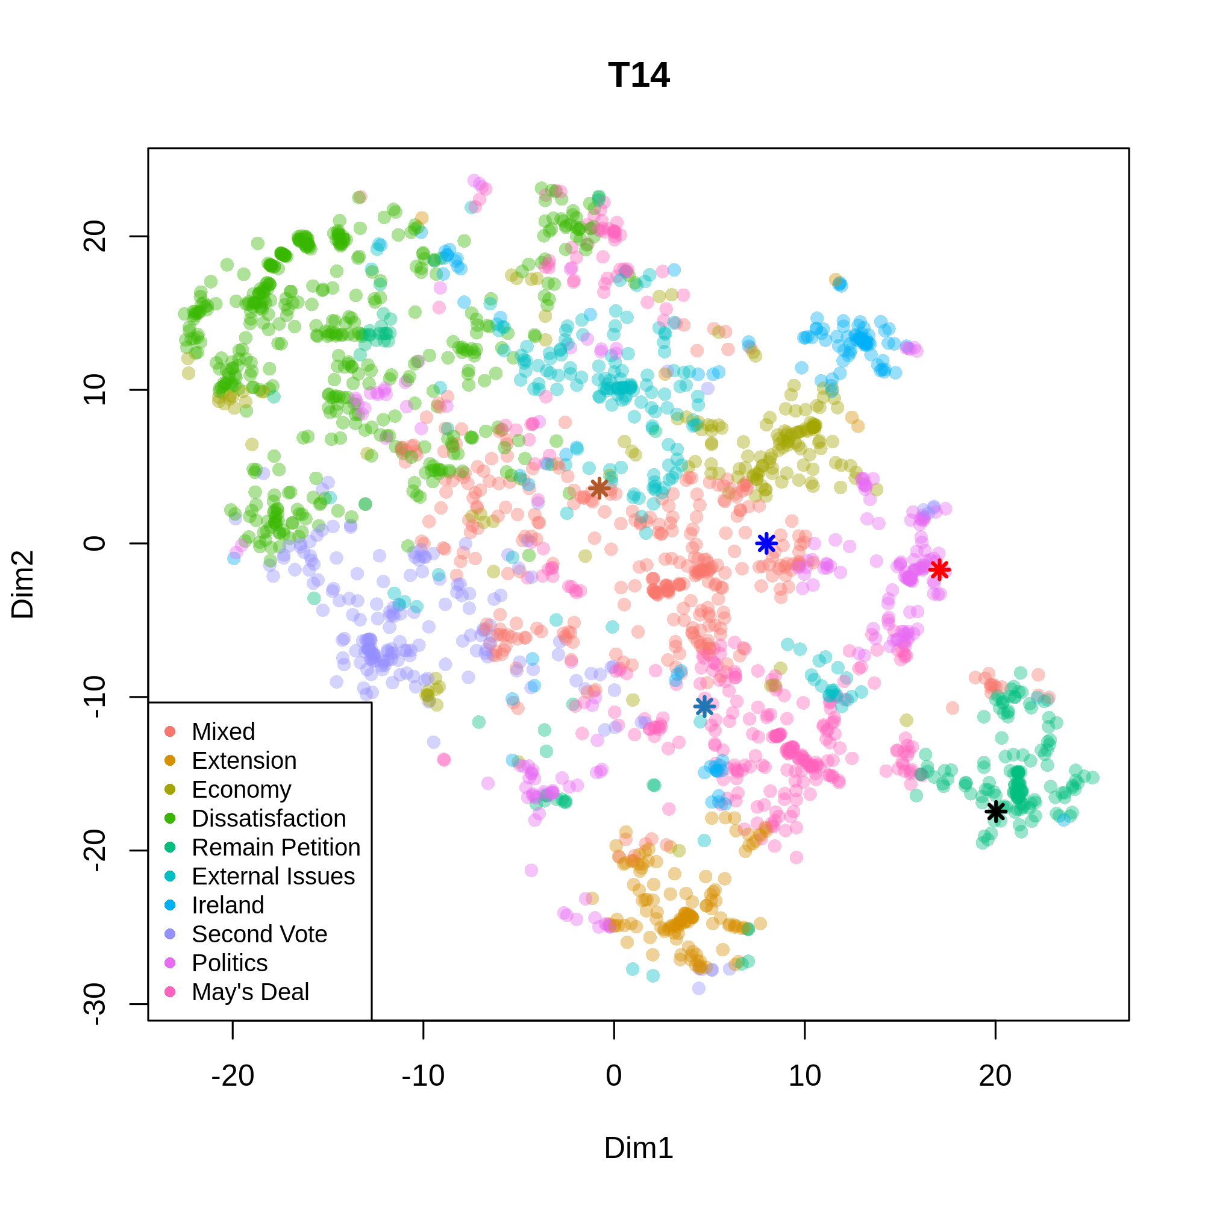
Longitudinal analysis of topic evolution

Slide 14
Presentation Outline
State of the Art
Dataset
Longitudinal analysis of topic evolution
Political Stance Predictor
Results
Conclusion and future work

Slide 15
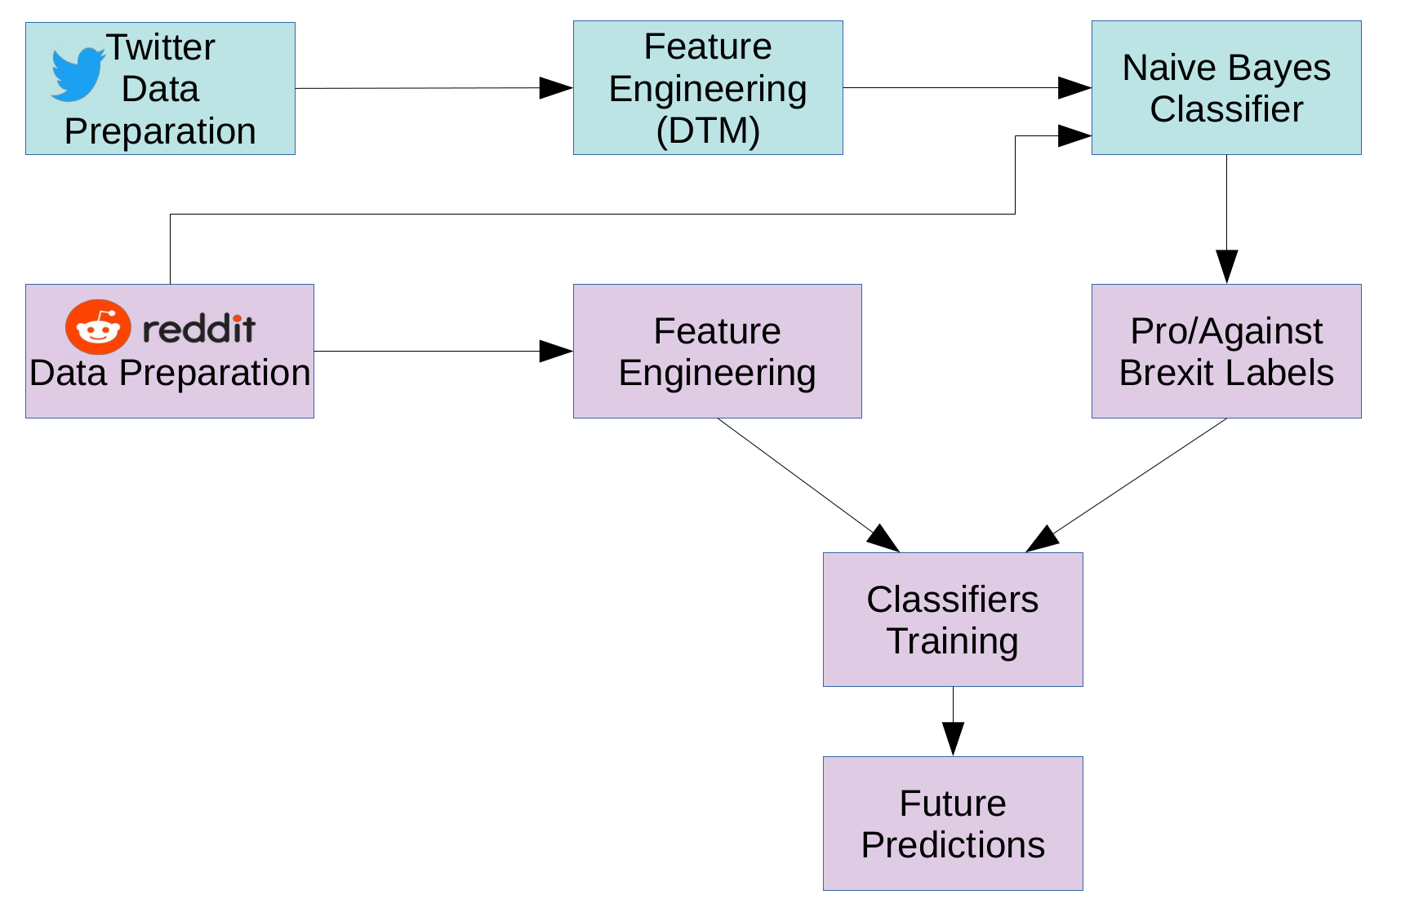
Political Stance Predictor
Notes:
Aim: predict users’ political stance (Against, Neutral, Brexit) changes in consecutive time-frames by analysing the interactions with other users and the structure of the conversations.
A classifier trained on Twitter is used to label users’ discourse as pro, against or neutral to Brexit.
Current stance and features extracted from the structure of the diffusions are used to predict the stance at the next time-period.

Slide 16
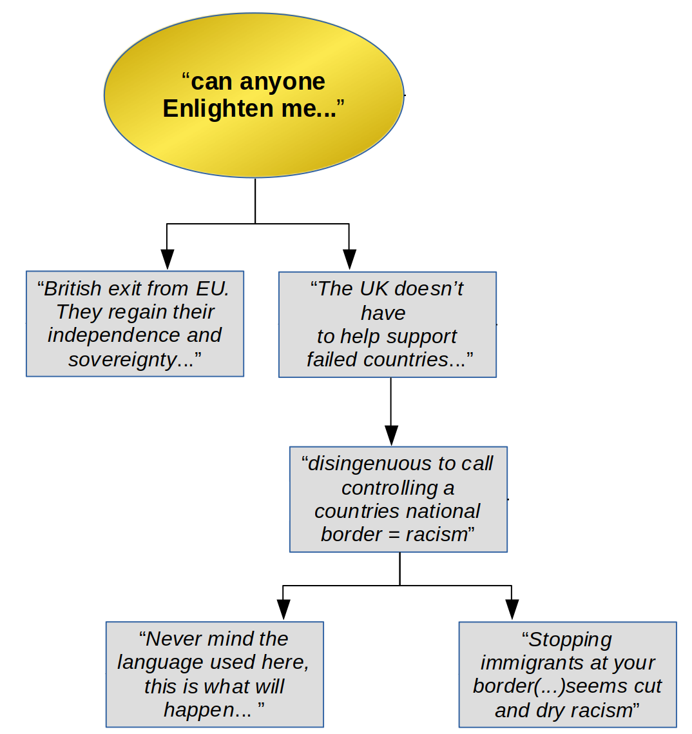
Features based on the structure of the diffusions
U1
FS1. User activity
U2
U3
User | # initiated threads | # submitted comments | # received replies per comment | Stance at current time-period
U1 | 1 | 1 | 2 2 2 2 2 | 2 (neutral)
U2 | 0 | 2 | 0 0 0 0 0 | 1 (brexit)
U3 | 0 | 2 | 0 0.25 0.5 0.75 1 | 0 (against)
U1
U2
U3
U3 has 2 utterances: for 1st one he receives one reply, for the 2nd one he receives 0.
[quantile(1, 0) = 0 0.25 0.5 0.75 1]

Slide 17
Features based on the structure of the diffusions
U1
FS2. User activity per group
User | # initiated threads | # submitted comments to |  |  | # received replies from |  |  | Stance at current time-period
 |  | against | neutral | brexit | against | neutral | brexit
U1 | 1 | 1 | 0 | 0 | 1 1 1 1 1 | 0 0 0 0 0 | 1 1 1 1 1 | 2 (neutral)
U2 | 0 | 2 | 0 | 0 | 0 0 0 0 0 | 0 0 0 0 0 | 0 0 0 0 0 | 1 (brexit)
U3 | 0 | 0 | 2 | 0 | 0 0 0 0 0 | 1 1 1 1 1 | 0 0 0 0 0 | 0 (against)
U2
U3
U1
U2
U3
U1 has 2 utterances and for each of them there is 1 reply from an against supporter.
[quantile(1, 1) = 1 1 1 1 1]
U1 has 1 utterance for which he received 1 reply from a neutral user.
[quantile(1) = 1 1 1 1 1]

Slide 18
Features based on the structure of the diffusions
U1
FS3. Structure of diffusion
User | % of comments in the initiated diffusions from |  |  | Stance at current time-period
 | against | neutral | brexit
U1 | 0.4 0.4 0.4 0.4 0.4 | 0.2 0.2 0.2 0.2 0.2 | 0.4 0.4 0.4 0.4 0.4 | 2 (neutral)
U2 | 0 0 0 0 0 | 0 0 0 0 0 | 0 0 0 0 0 | 1 (brexit)
U3 | 0 0 0 0 0 | 0 0 0 0 0 | 0 0 0 0 0 | 0 (against)
U2
U3
U1
U2
U3
One initiated diffusion, in which 2/5 comments are against
[quantile(0.4) = 0.4 0.4 0.4 0.4 0.4]
All 0 because U2 and U3 don't initiate diffusions

Slide 19
Features based on the structure of the diffusions
FS4. All features
Aggregation of the previous 3 feature sets, with elimination of common columns.
FS1 + FS2 + FS3

Slide 20
Classifiers
Logistic regression
k-NN
Random Forest [Ho, 1995]
Gradient Boosting [Friedman, 2001]
XGBoost [Chen&Guestrin, KDD'16]
Hyperparameters tuning using Randomized Search 3-fold Cross Validation
Evaluation using 10-fold Cross Validation
Reporting mean and standard deviation of F1 Score.
Notes:
We trained 5 off-the shelf classifiers
Training: On each tuning we do 40 random initializations
Evaluation: the dataset is divided into 10 folds, a prediction model is developed based on 9 folds and then tested on the 10th fold

Slide 21
Presentation Outline
State of the Art
Dataset
Longitudinal analysis of topic evolution
Political Stance Predictor
Results
Conclusion and future work

Slide 22
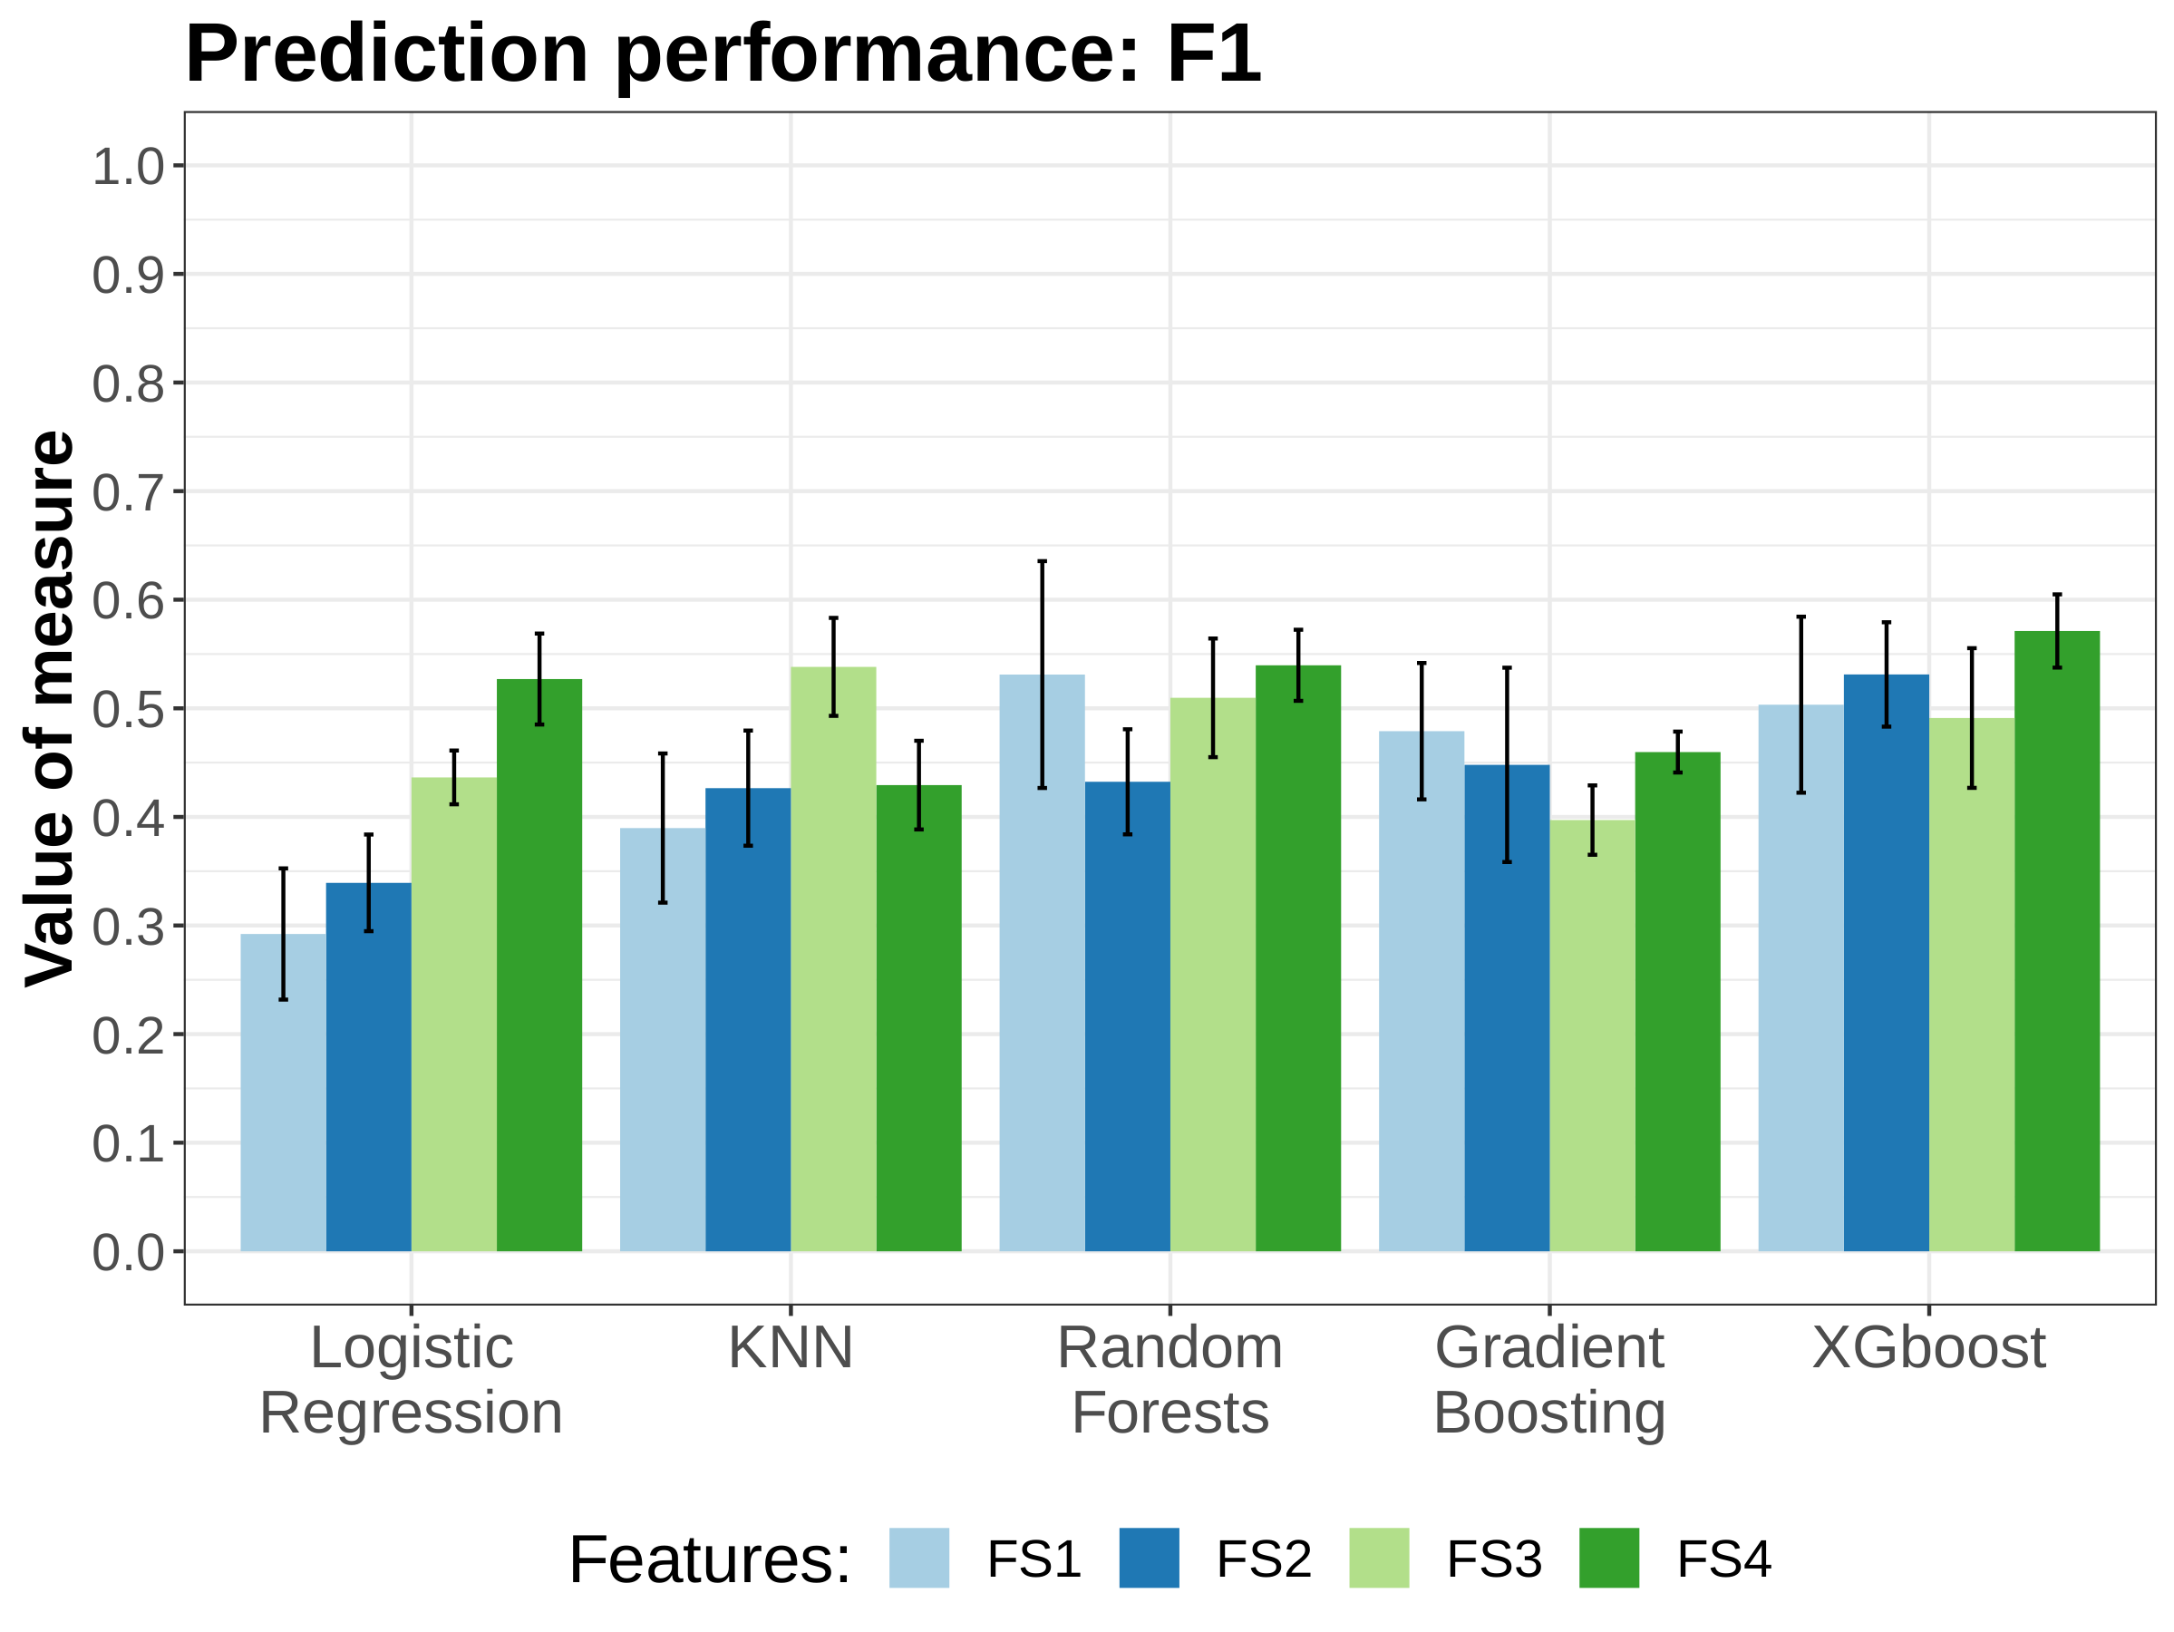
Results
Good F1 scores obtained by most predictors (3-class prediction problem);
The best predictor is XGBoost trained with FS4 (F1 = 0.57, sdev = 0.03);

Slide 23
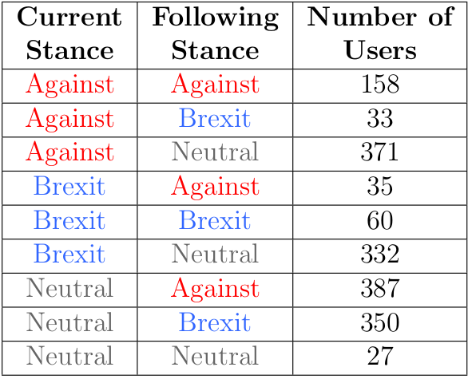
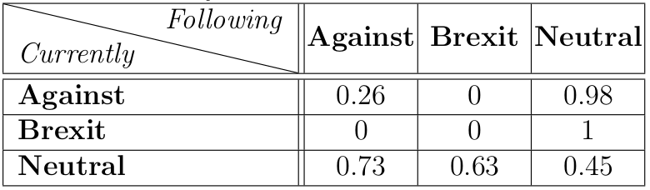
F1 score by transition type
Promising results when predicting future stance for Neutral users
The quality of the predictions is proportional with the number of users performing these transitions.

Slide 24
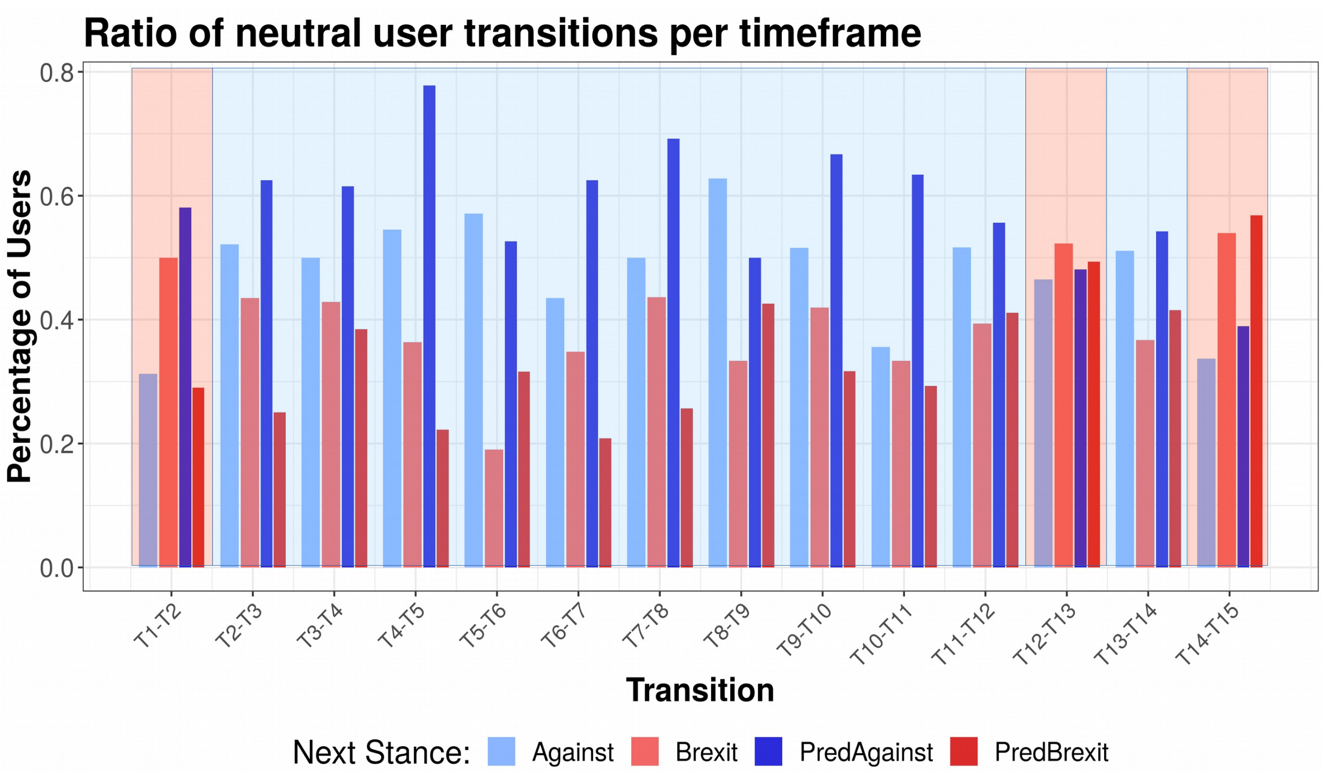
Predicting Neutral users behaviour
Notes:
We managed to predict correctly the sudden alternation from the last 3
transitions. This allows us to anticipate the sizes of the new groups in
consequent periods, a useful result especially for polling agencies.
Neutral users transition ratios: in transition 1-2 more users changed to Against,
in the next 10 transitions users migrated more to Brexit. A sudden change appears in
transition 12 - 13.

Slide 25
Presentation Outline
State of the Art
Dataset
Longitudinal analysis of topic evolution
Political Stance Predictor
Results
Conclusion and future work

Slide 26
Conclusion
• Longitudinal analysis of discussions around Brexit on two social media platforms: Twitter and Reddit;
• Tool for visualizing the dynamics of discussion topics and trajectory of users;
• Prediction of future political stance based on features defined using the structure online diffusions;

Slide 27
Future work
Label user stances for Reddit using Figure-Eight and train a stance classifier on the new labeled data;
Build a new feature set based on textual information;
Re-apply same methodology for Twitter Dataset;
Notes:
0. the results are intermediate and can be regarded as a proof of concept, as important improvements will be made in the remaining time of this internship
1. use propensity scores (from Twitter classifier) to sample a representative population of Reddit users to label manually by Figure-Eight workers;
2. -- we know we have retweet information, therefore we can reconstruct cascades and apply same methodology;

Slide 28

Thank you very much for your attention!
andrei.mardale@etu.univ-st-etienne.fr

Slide 29
References
Chen T, Guestrin C (2016) XGBoost: A Scalable Tree Boosting System in Proceedings of the 22nd ACM SIGKDD International Conference on Knowledge Discovery and Data Mining - KDD ’16. (ACM Press, San Francisco, California, USA), pp. 785–794
Friedman J (2001) Greedy function approximation: A gradient boosting machine. Annals of Statistics 29:1189–1232.
Ho T (1995) Random decision forests in 3rd International Conference on Document Analysis and Recognition. (IEEE, Montreal, QC, Canada), pp. 278–282.
van der Maaten L, Hinton G (2008) Visualizing high-dimensional data Using t-SNE. Journal of Machine Learning Research 9:2579–2605.
Blei, D. M., Ng, A. Y., & Jordan, M. I. (2003). Latent dirichlet allocation. Journal of machine Learning research, 3(Jan), 993-1022.
Reynolds AP, Richards G, de la Iglesia B, Rayward-Smith VJ (2006) Clustering Rules: A Comparison of Partitioning and Hierarchical Clustering Algorithms. Journal of Mathematical Modelling and Algorithms 5(4):475–504.

